Slide 2

Project Mentor Hub Communication Subsystem
Bao Ly | 03.06.2024

Slide 3

Agenda
Overview
Use Case Diagram
UI Designs
Database Designs
References

Slide 4
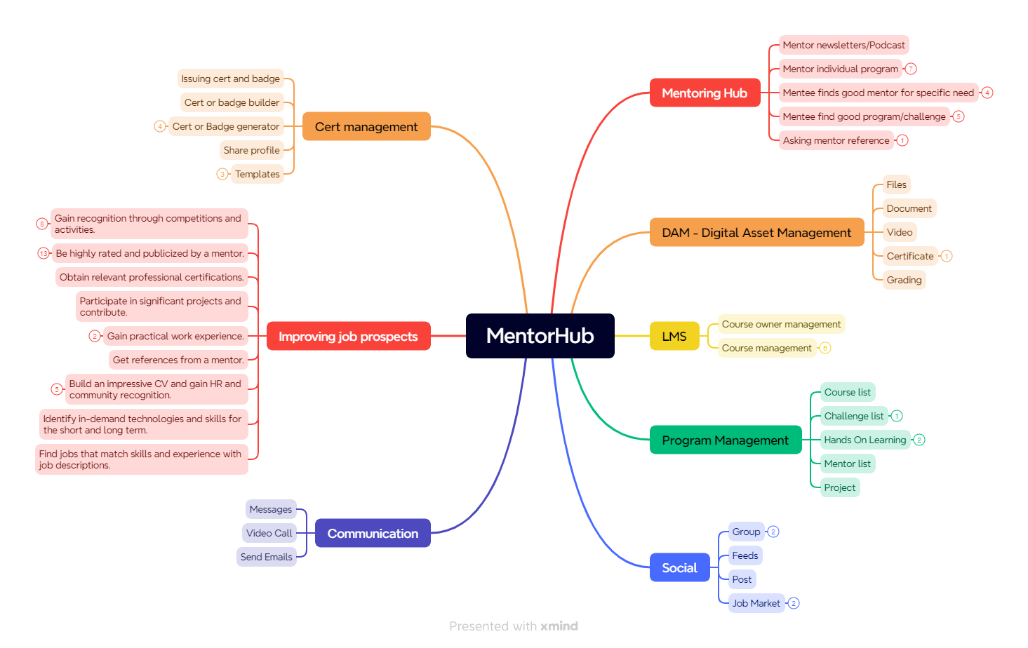
Overview – Mentor Hub

Slide 5
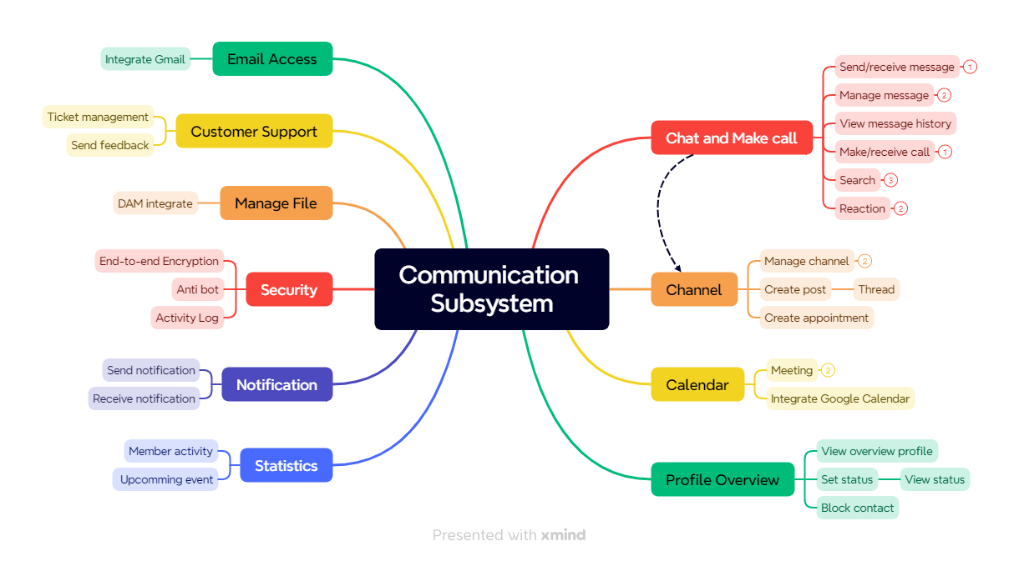
Overview – Communication Subsystem

Slide 6
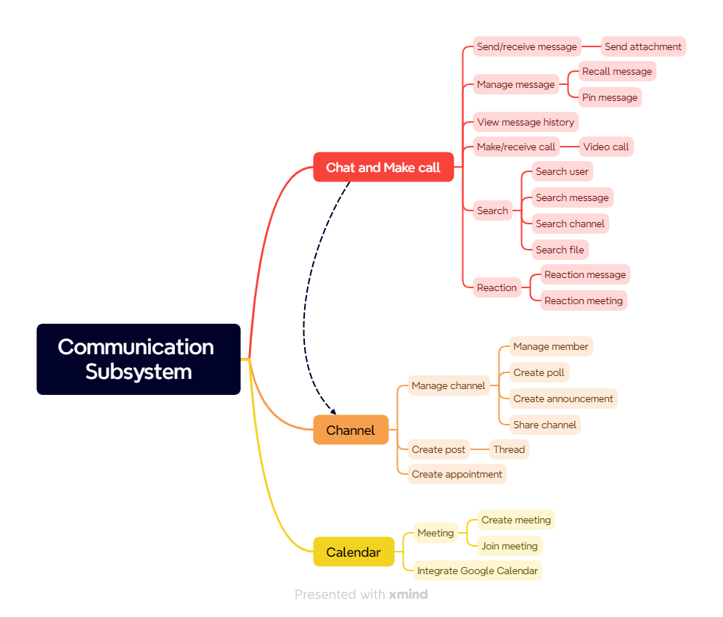
Overview – Communication Subsystem

Slide 7
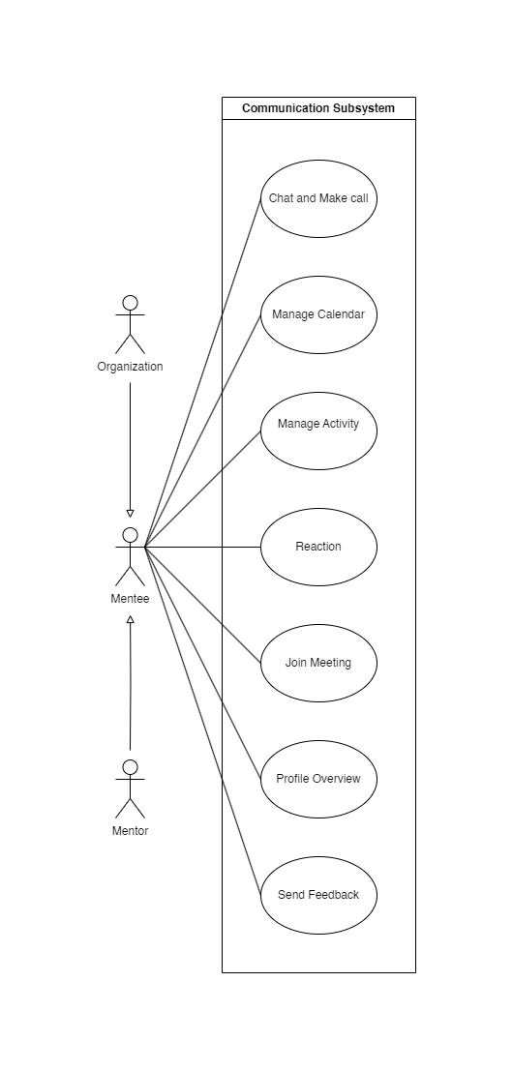
Use Case Diagram – High Level
4 actors:
Mentor
Mentee
Organization
System

Slide 8
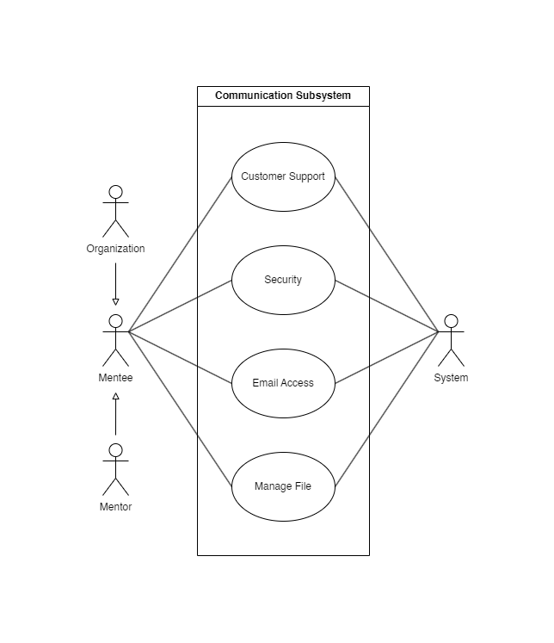
Use Case Diagram – High Level
4 actors:
Mentor
Mentee
Organization
System

Slide 9
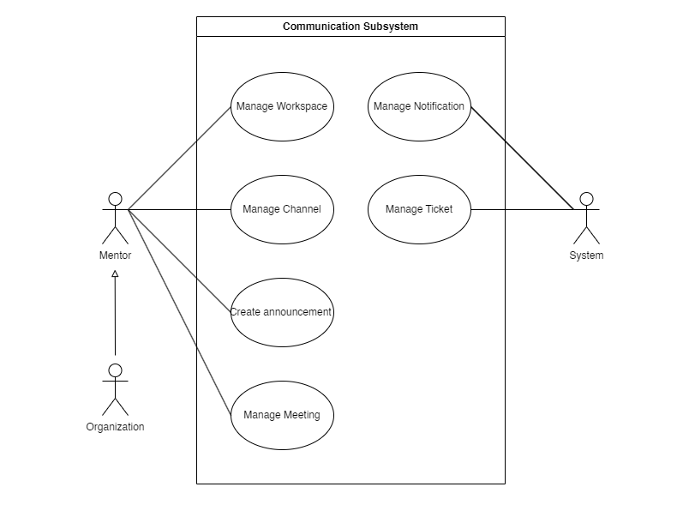
Use Case Diagram – High Level
4 actors:
Mentor
Mentee
Organization
System

Slide 10
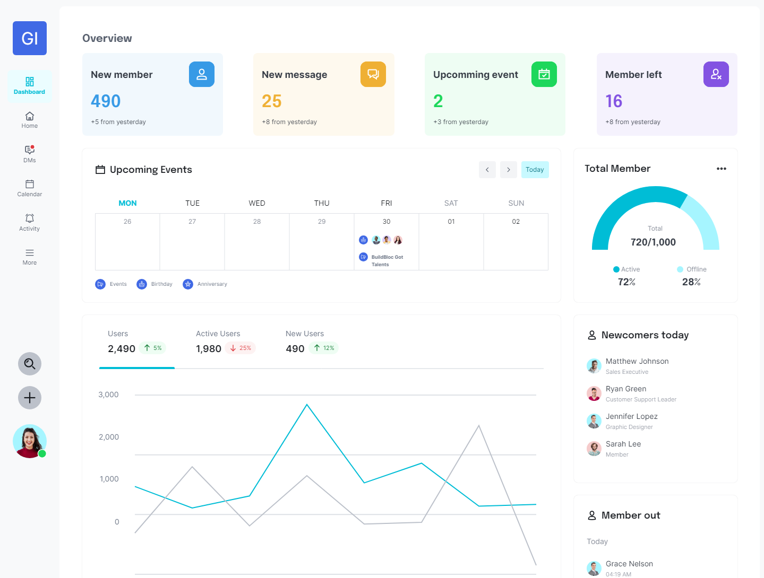
UI Design – Dashboard

Slide 11
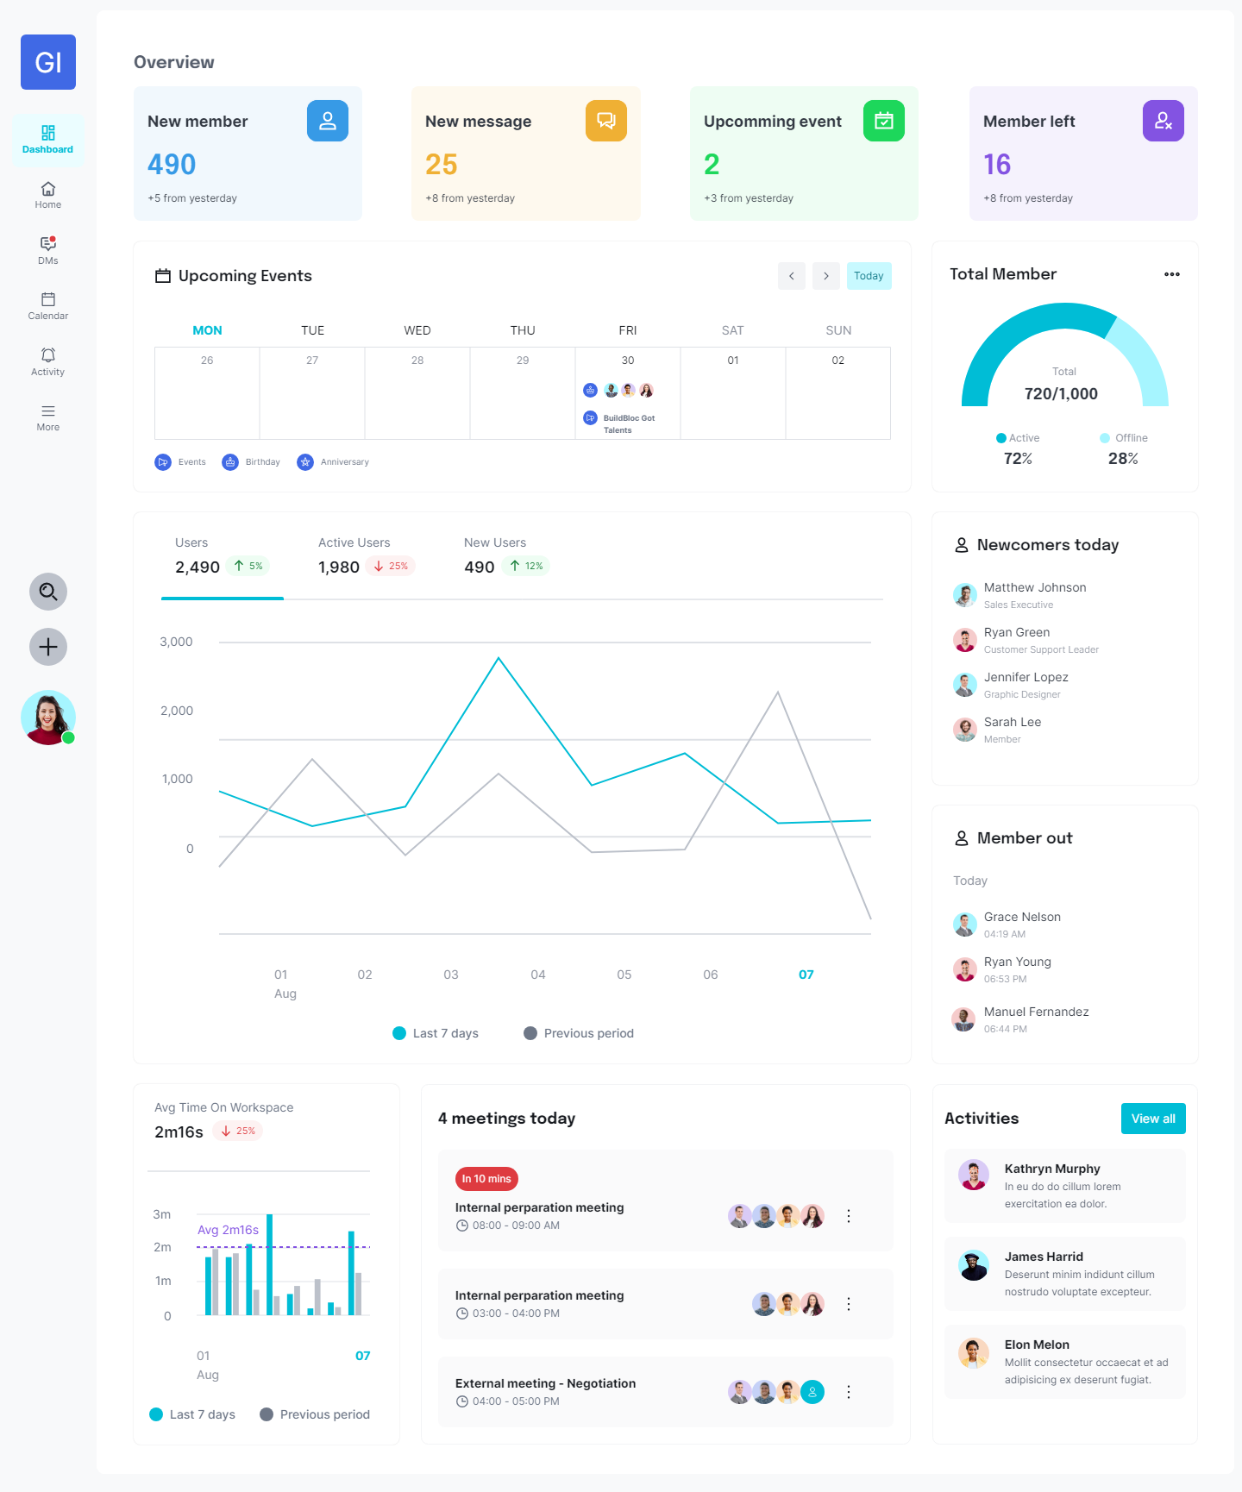
UI Design – Dashboard

Slide 12
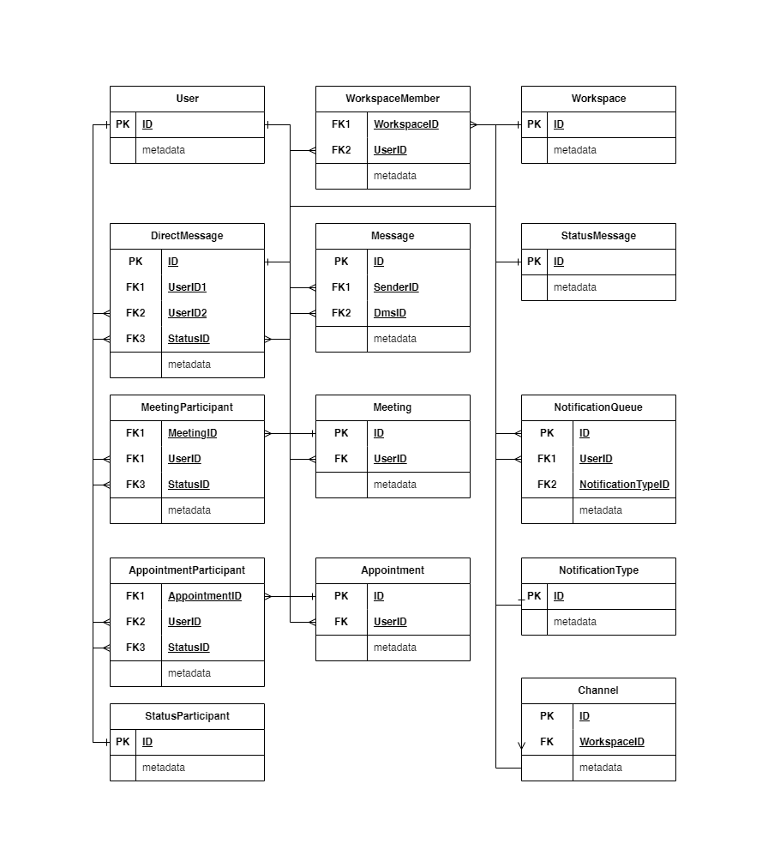
UI Design – Dashboard

Slide 13
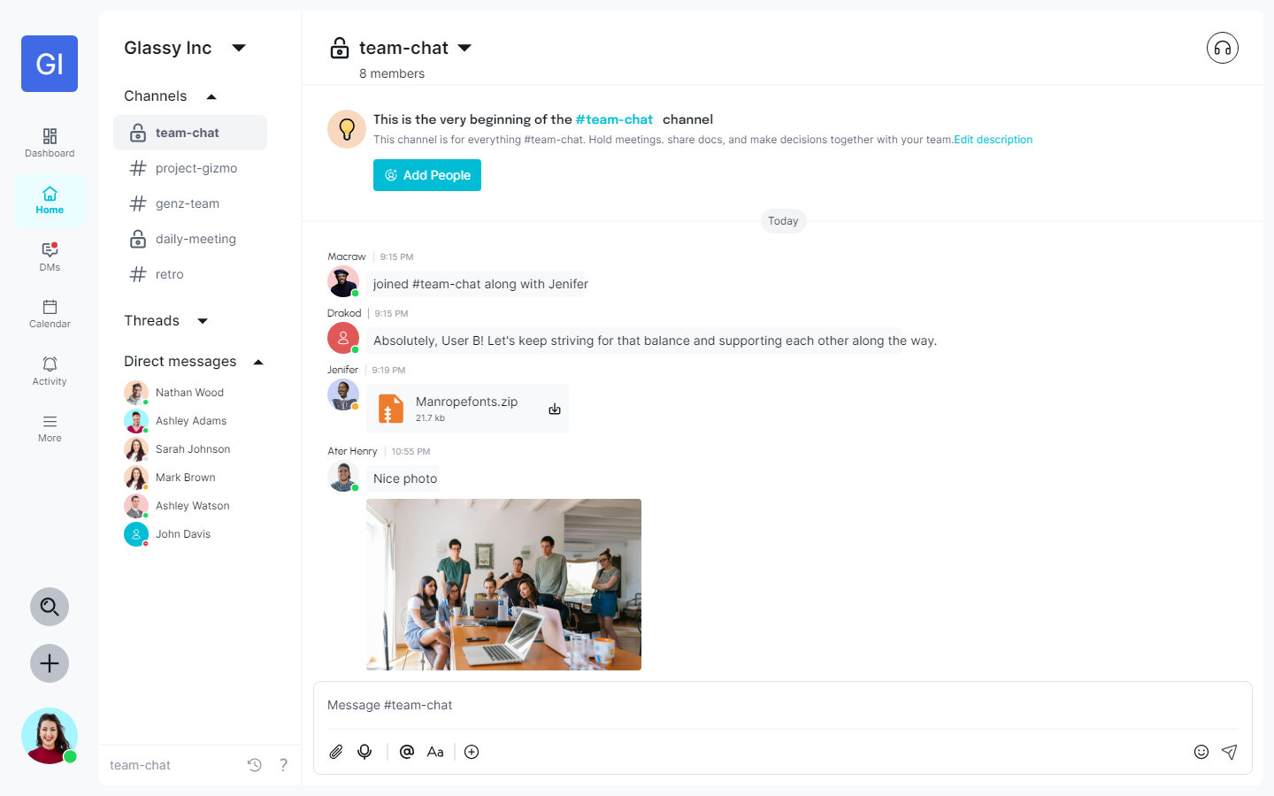
UI Design – Workspace

Slide 14
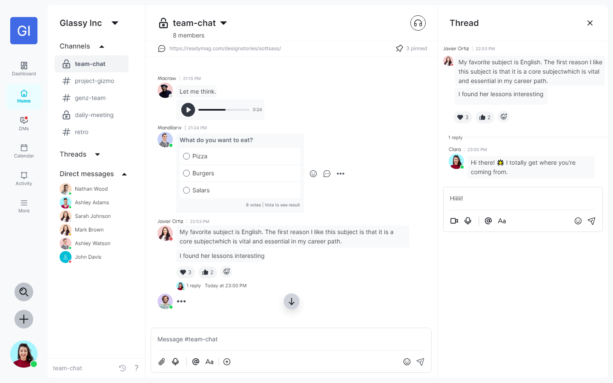
UI Design – Workspace

Slide 15
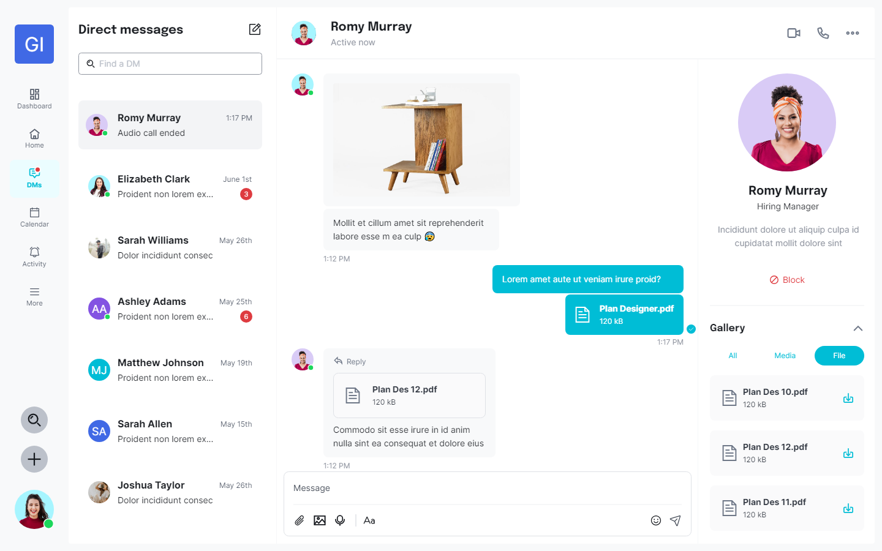
UI Design – Direct Messages

Slide 16
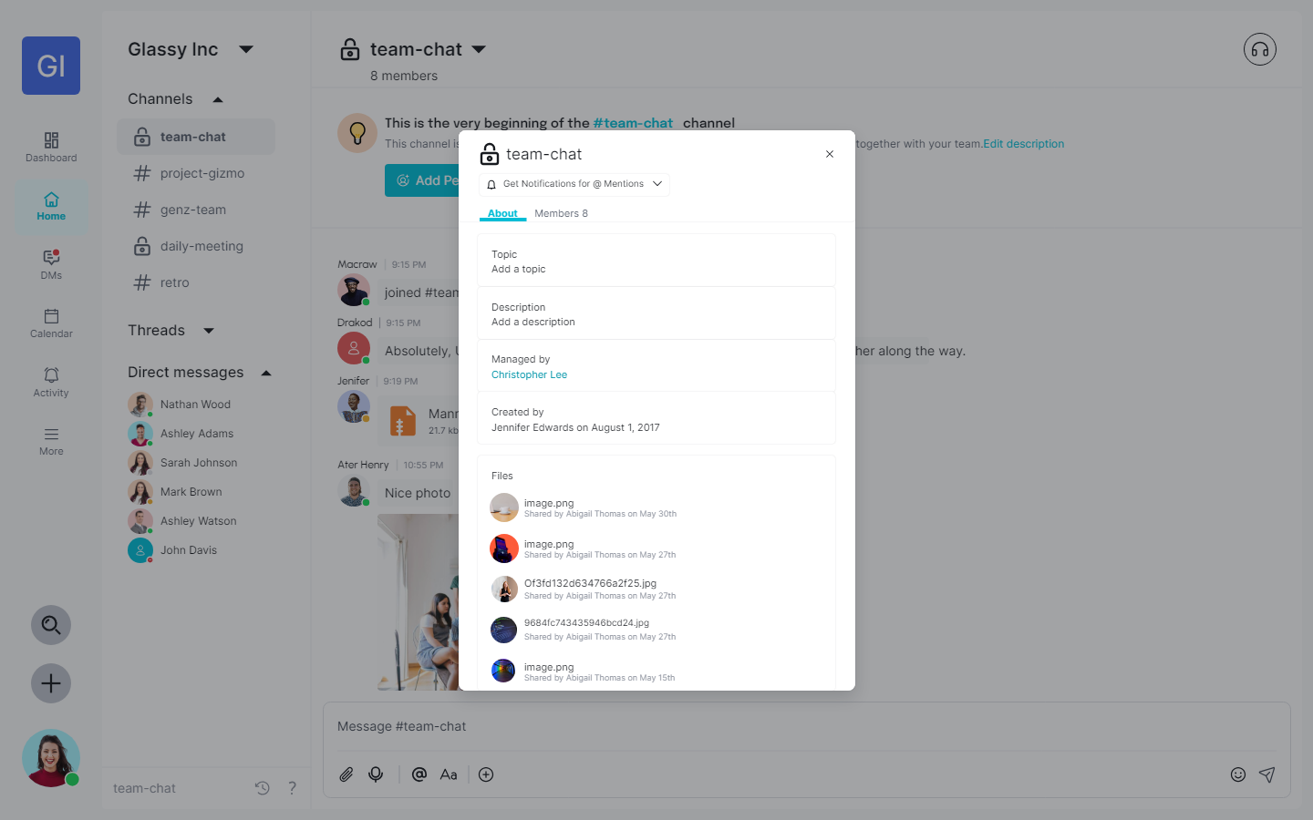
UI Design – Manage channel

Slide 17
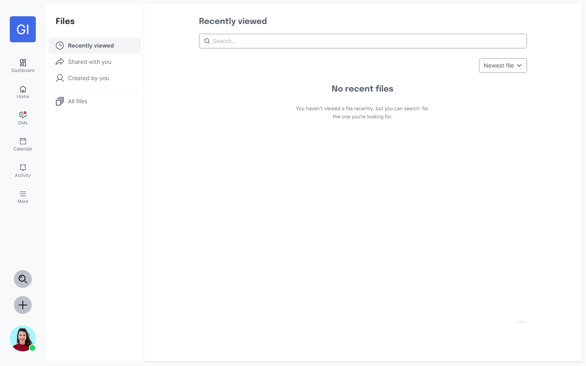
UI Design – Files

Slide 18
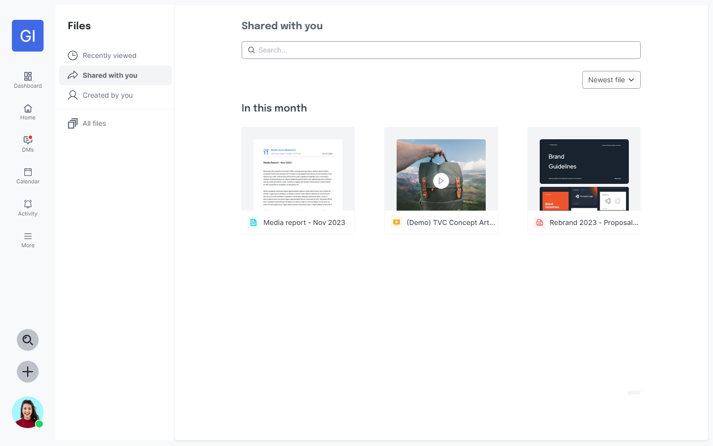
UI Design – Files

Slide 19
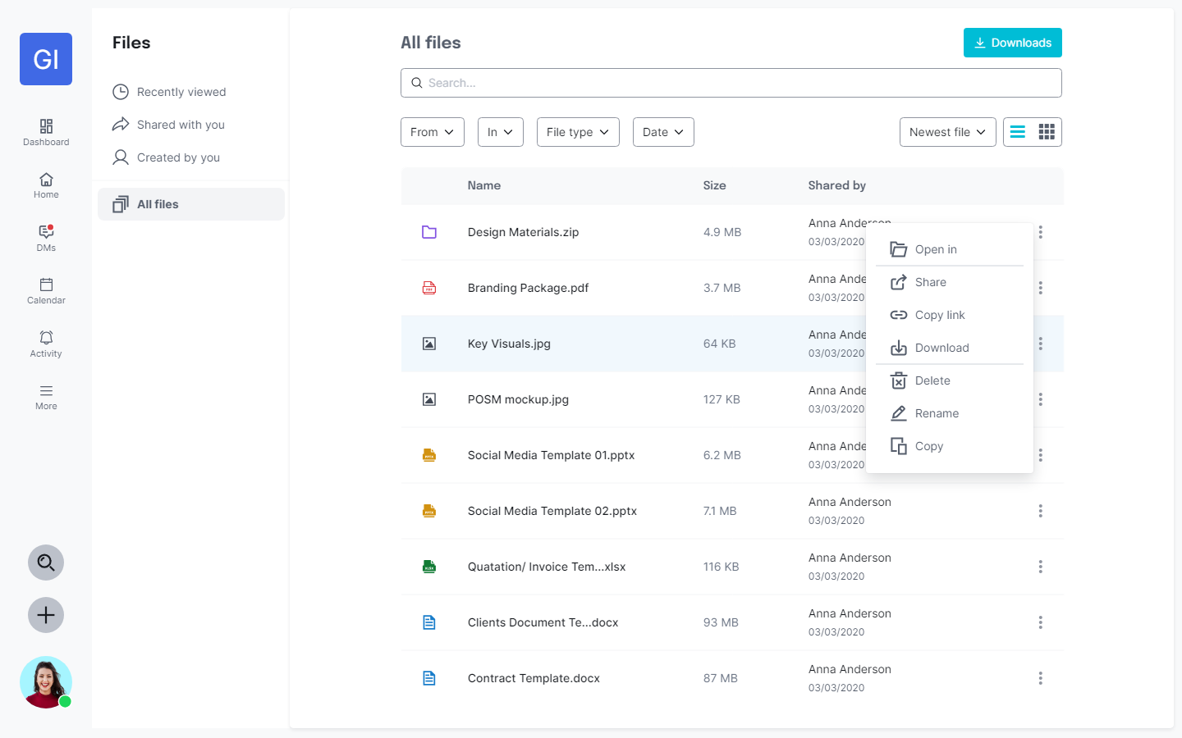
UI Design – Files

Slide 20
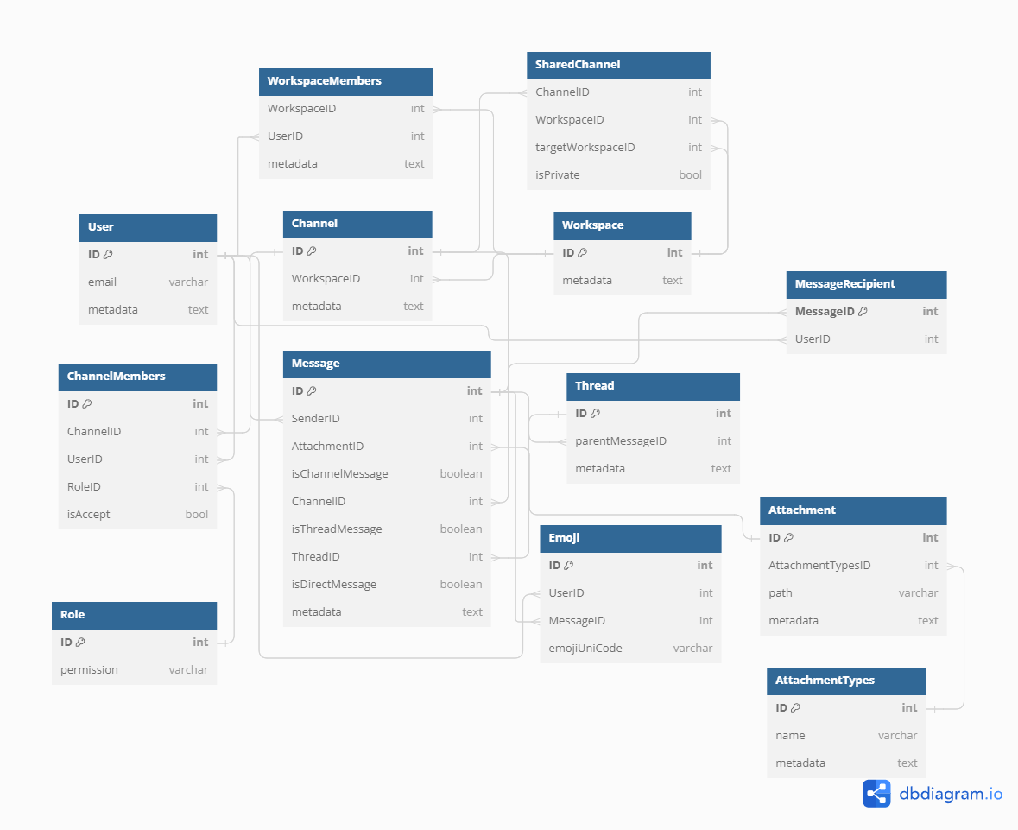
Database Design

Slide 21
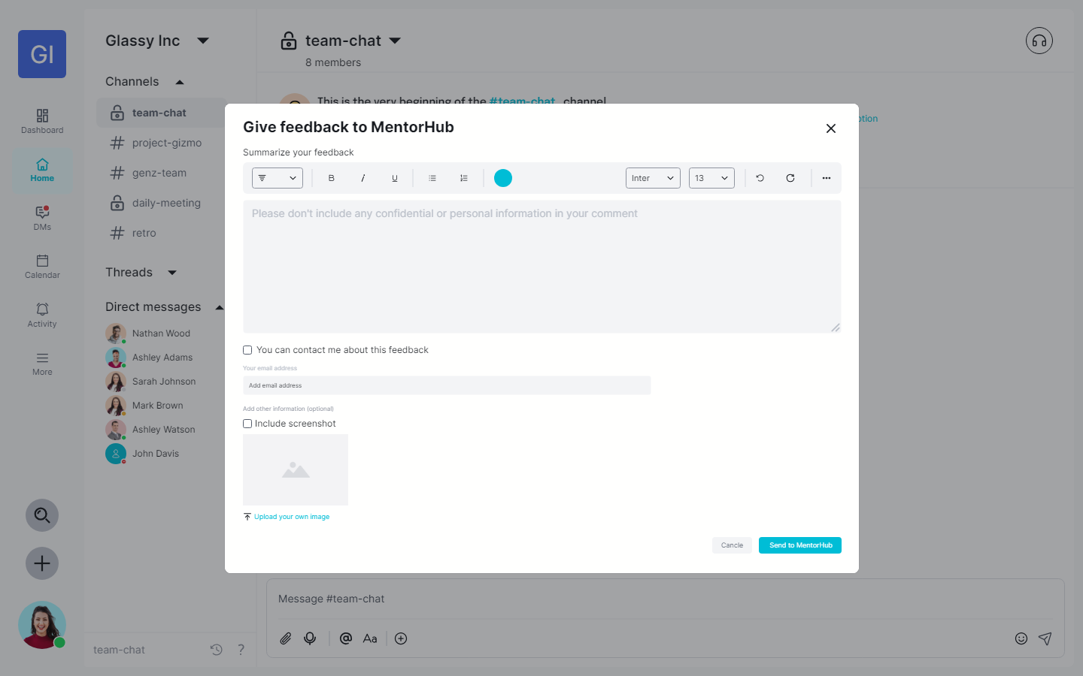
UI Design – Give feedback

Slide 22
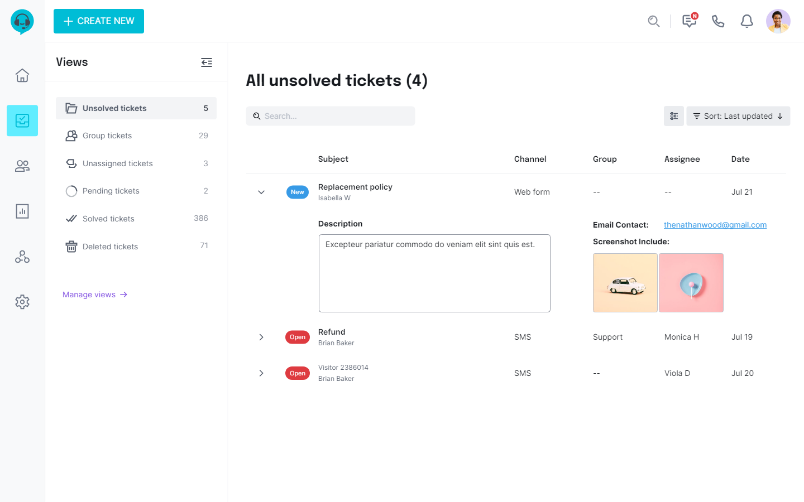
UI Design – Manage Ticket

Slide 23
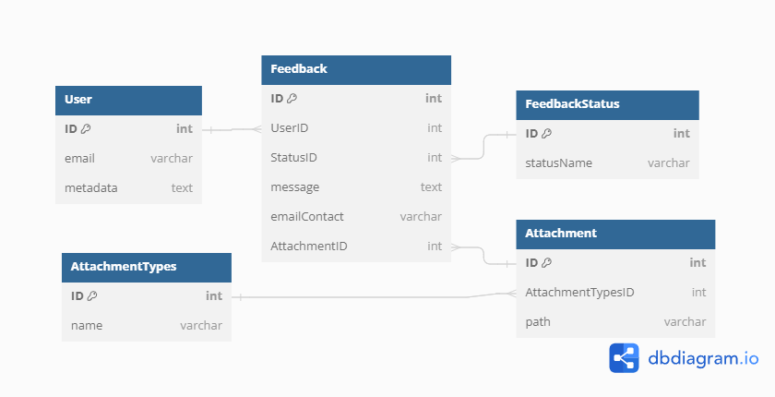
Database Design

Slide 24
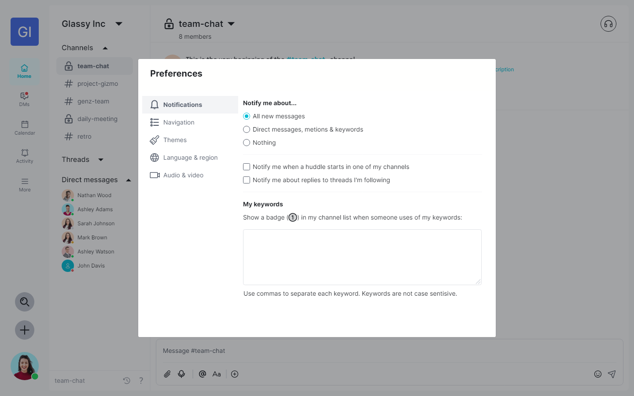
UI Design – Preferences

Slide 25
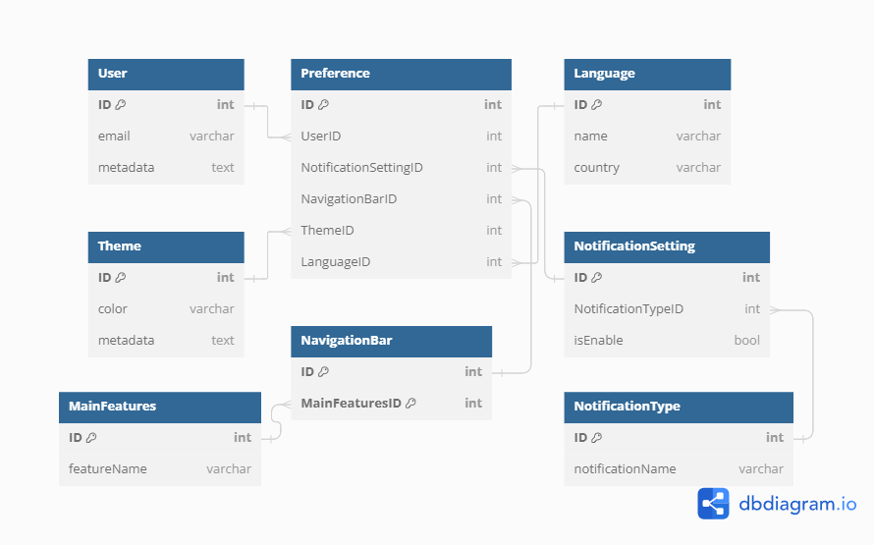
Database Design

Slide 26
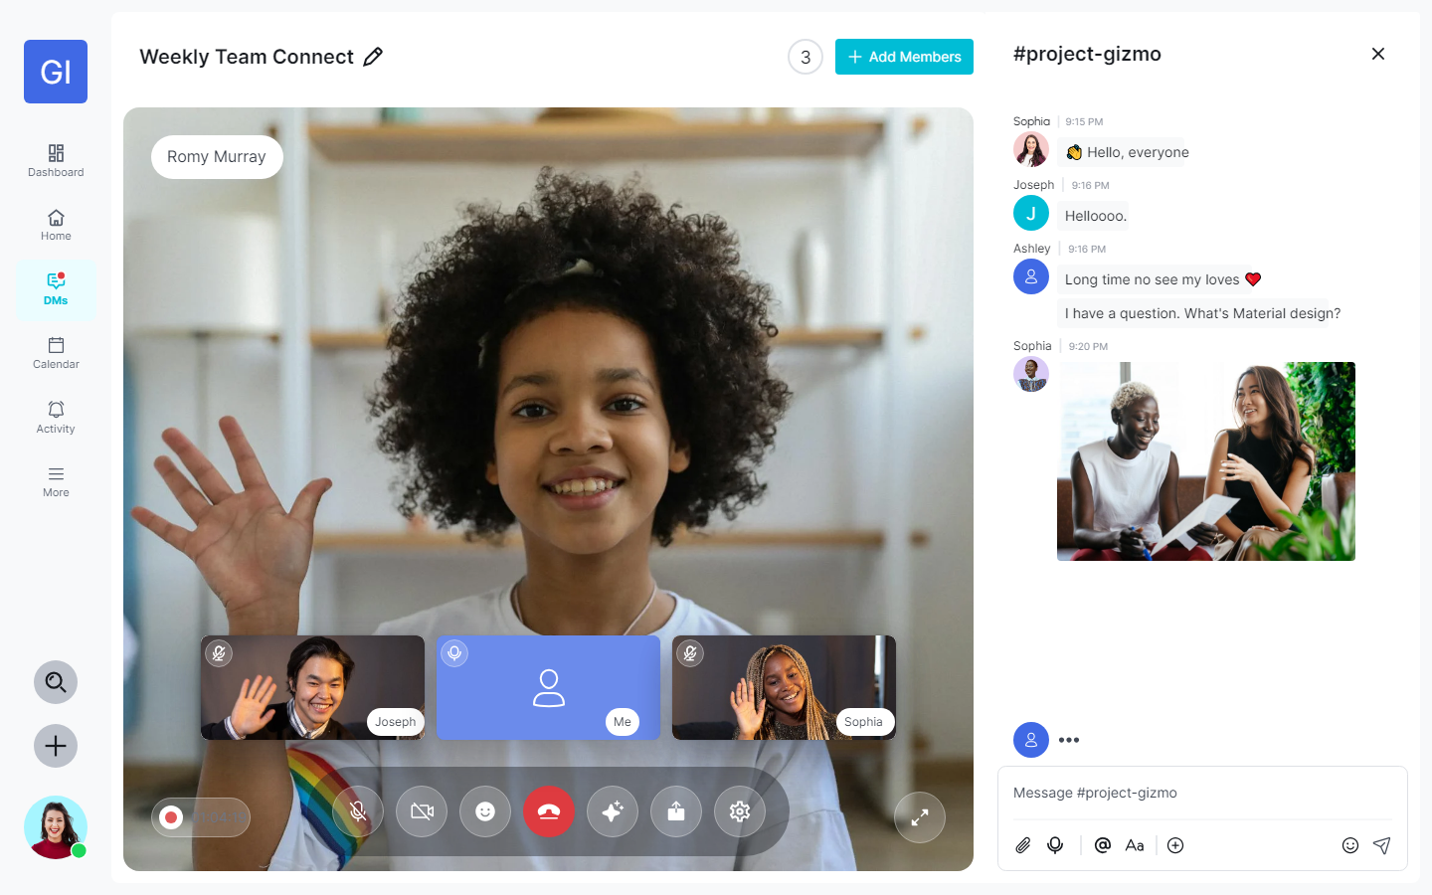
UI Design – Video Call & Meeting

Slide 27
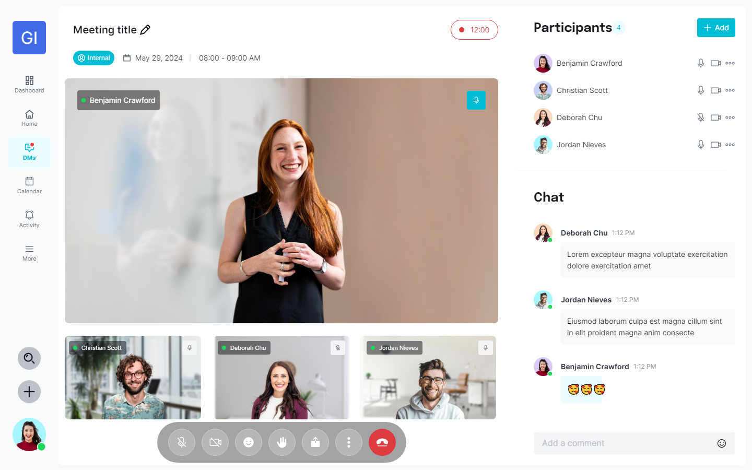
UI Design – Video Call & Meeting

Slide 28
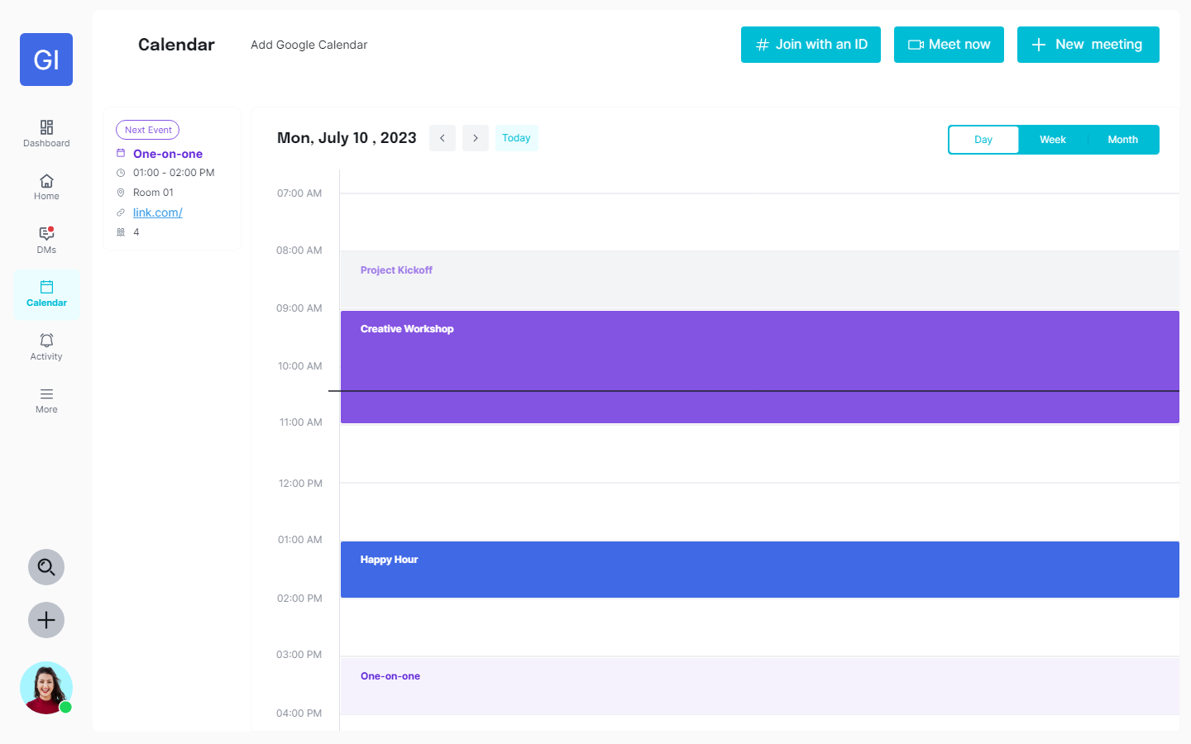
UI Design – Calendar

Slide 29
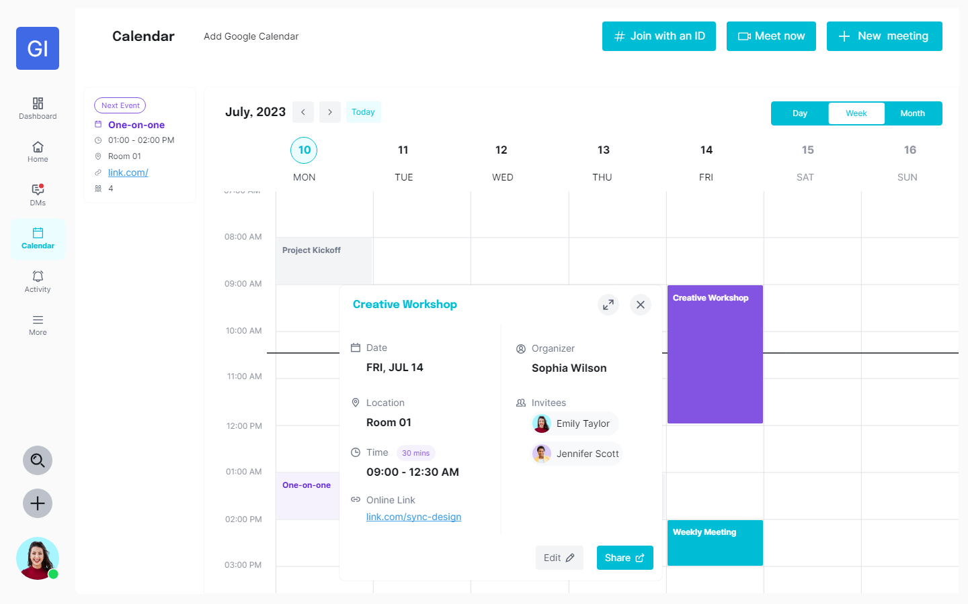
UI Design – Calendar

Slide 30
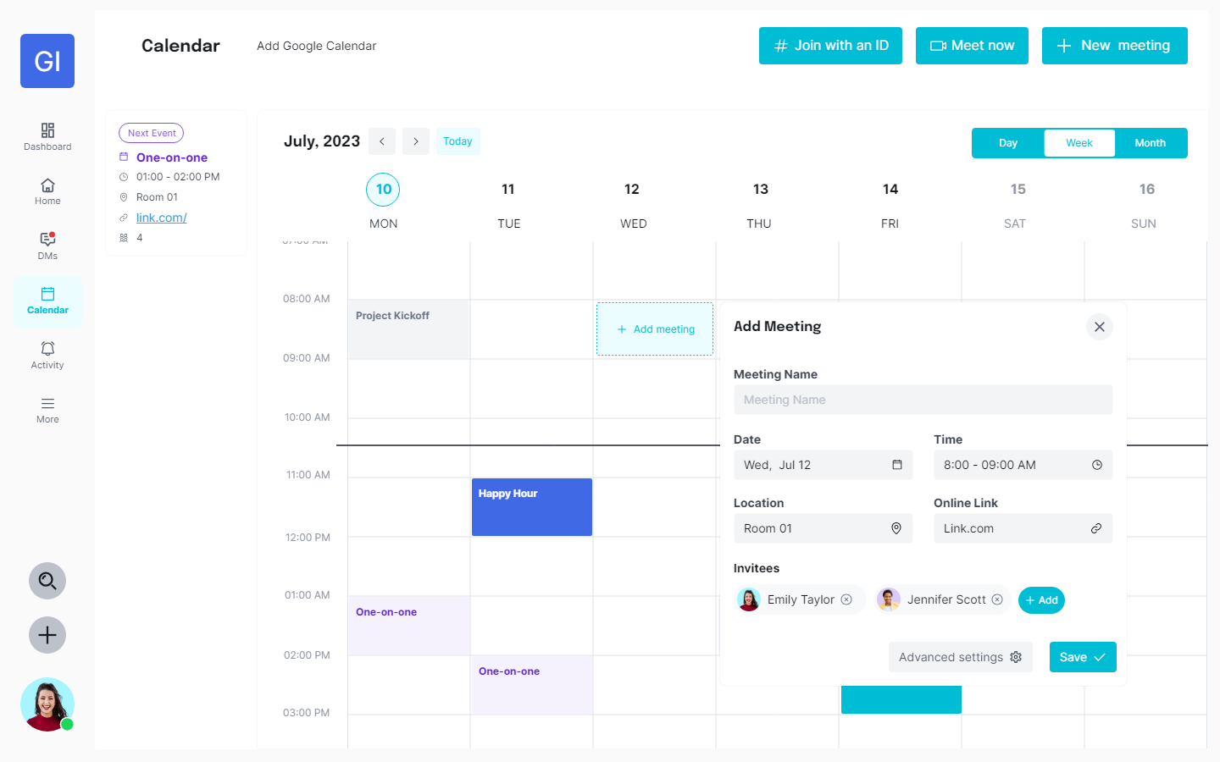
UI Design – Calendar

Slide 31
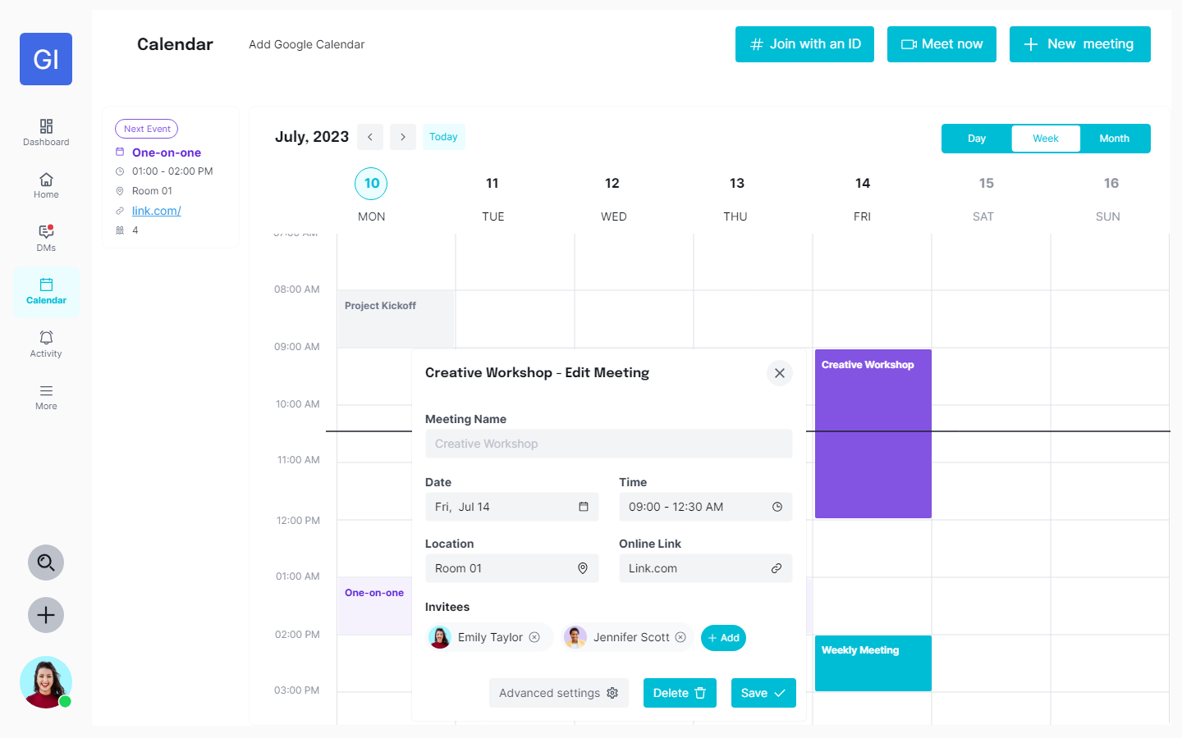
UI Design – Calendar

Slide 32
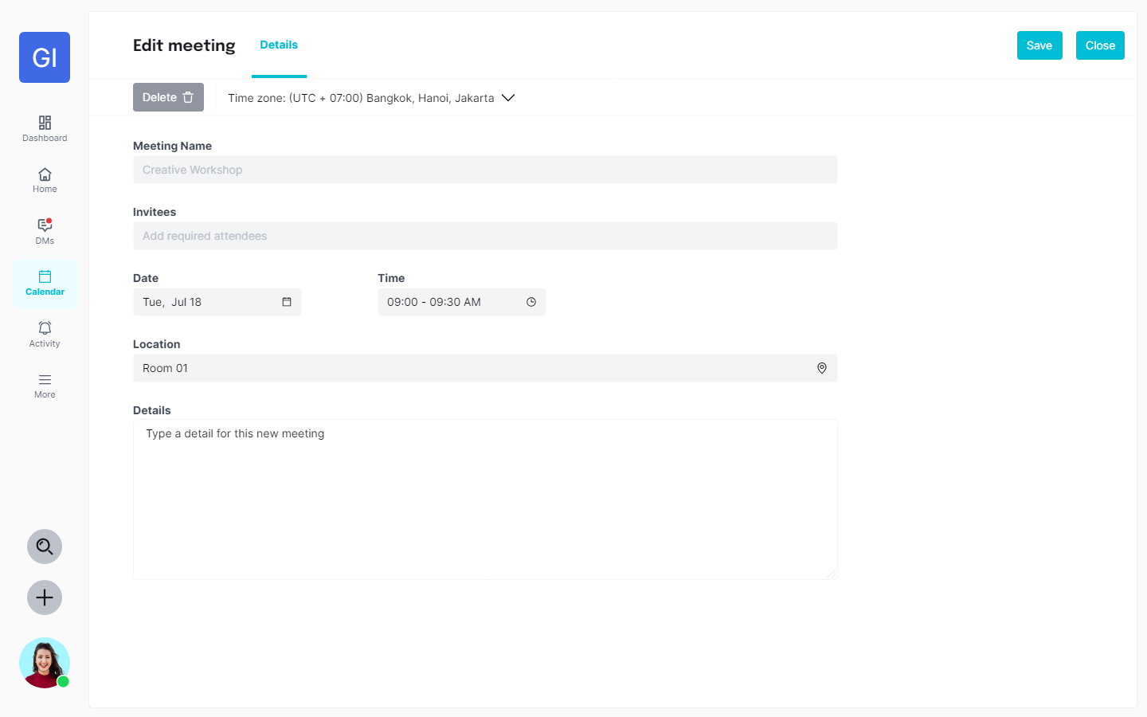
UI Design – Calendar

Slide 33
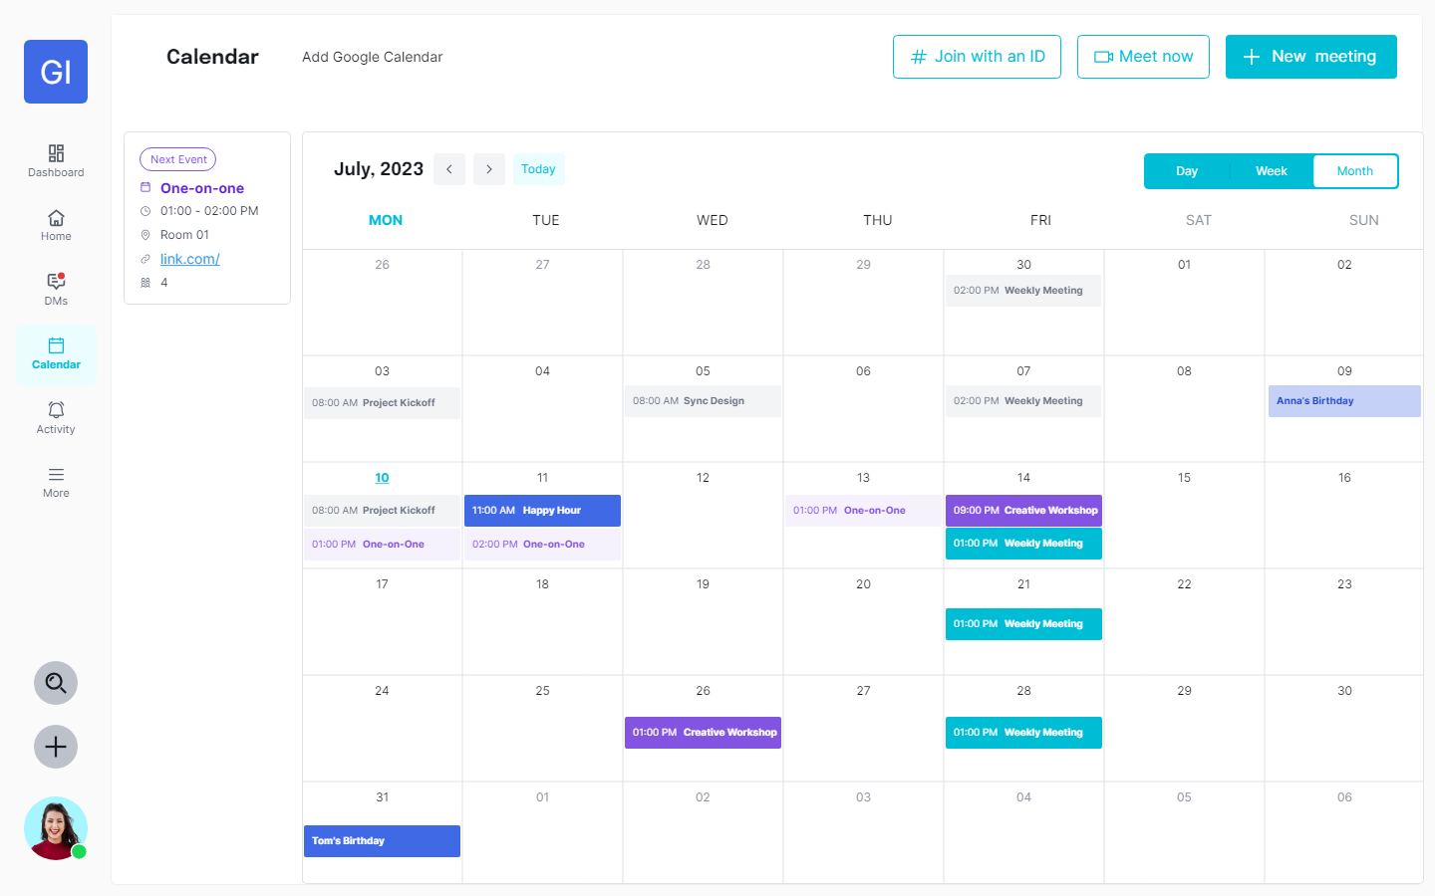
UI Design – Calendar

Slide 34
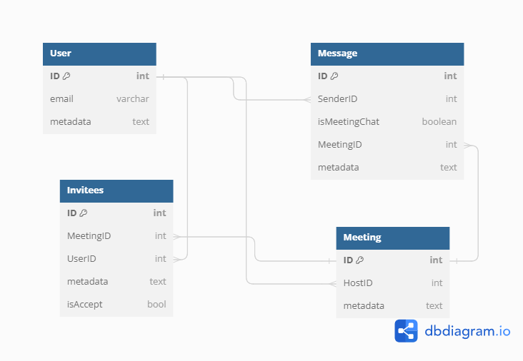
Database Design

Slide 35
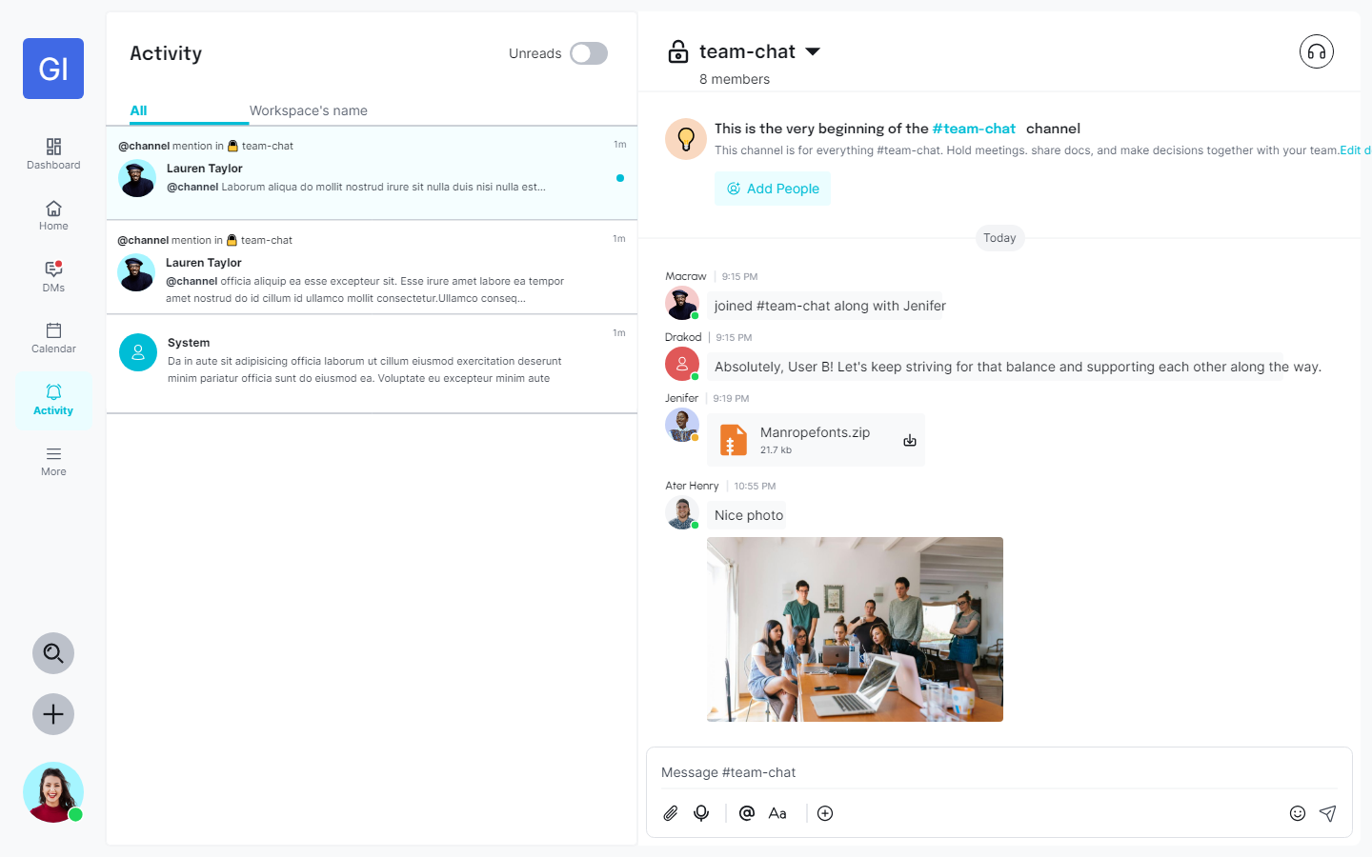
UI Design – Activity

Slide 36
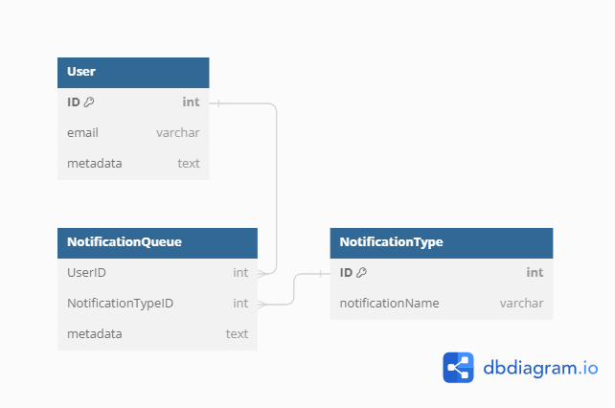
Database Design

Slide 37
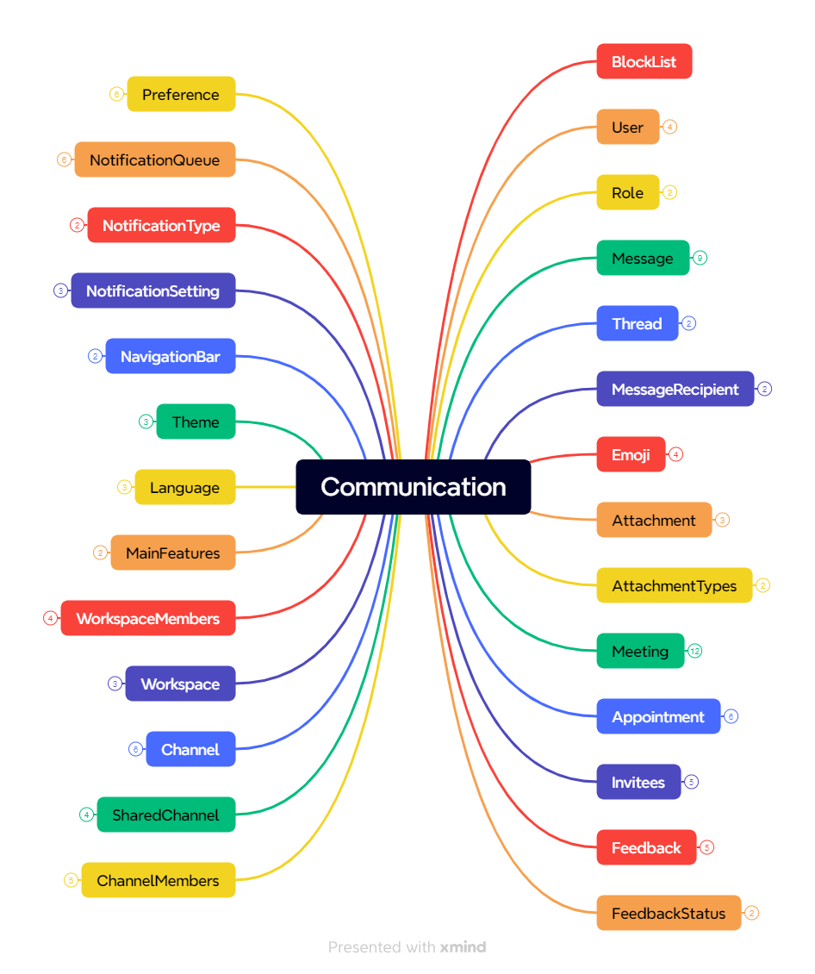
Database Design - Overview

Slide 38
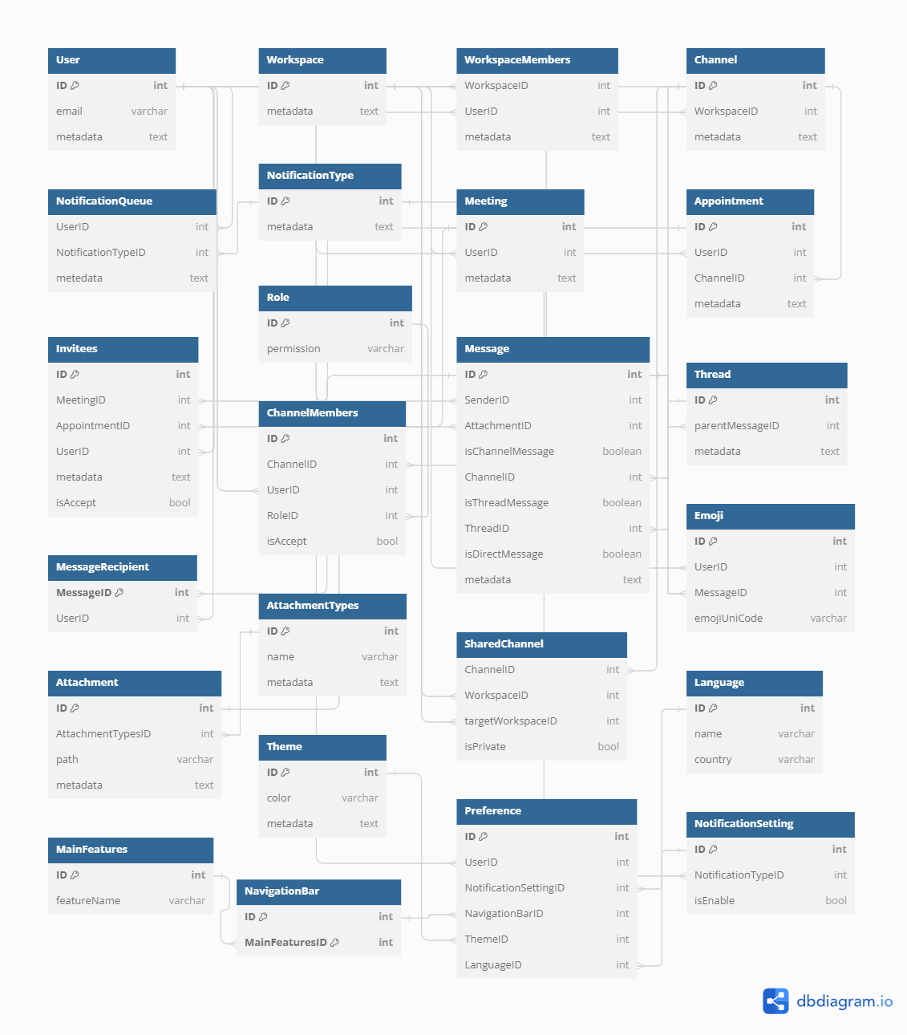
Database Design - Overview

